Slide 1
Gem classification with Deep Learning
Simon Henley
6/2/19

Slide 2
Aim
Train a convolutional neural network (CNN) to classify images of stone by shape (“Round”, “Heart” etc.)
Investigate if a CNN classification scheme plus inter-class interpolation can “classify” the stone rotation angle to predict stone rotation angle to an acceptable tolerance

Slide 3
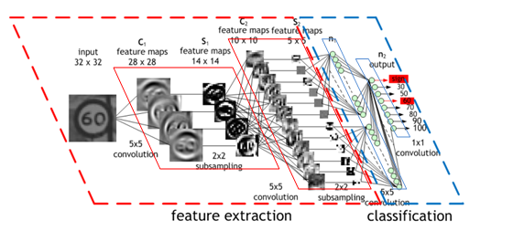
CNNs
CNNs are very good at image classification as they learn by self-generating feature maps (“spatial filters”) of the image, by convolution, and observing which of these filters are strongly activated by an image. This allows the classification to be insensitive to the location of the object with in the image.

Slide 4
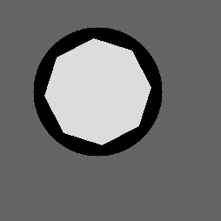
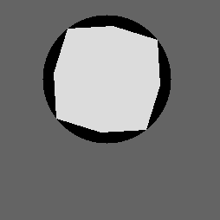

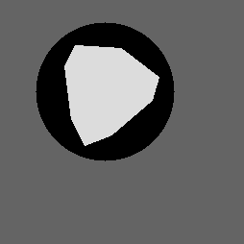
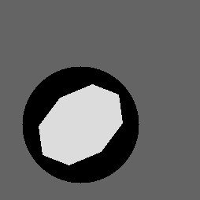
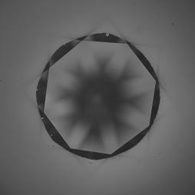
Stone types
Aim was to classify simulated images of stones into one of 5 classes.
As we didn’t have access to large numbers of pre-classified real images so simulated images were used for the first tests. Stone of different sizes, positions and angles were generated.
Round
Princess
Baguette
Heart
Oval
Example real stone image (Round brilliant)

Slide 5
Network
A CNN with 4 convolution layers and 2 Dense layers was generated in Keras (high level Tensoflow API in Python.)
40,000 simulated images were generated between all 5 classes.
This set was split into 20,000 images for training, 10,000 images for model validation and 10,000 images for testing.
Image size was 254 x 254 pixels, 3 channel greyscale.
Prior to training the image colour was normalised from 0 -> 255 to 0.0 -> 1.0 to allow efficient training.
Training was performed on a GPU (Nvidia GeForce GTX 1070 with CUDA 9 drivers.)
Learning rate was fixed at 2e-5 and a mean-square error loss function was used.
Run time was ~ 1hour with GPU acceleration.
Layer (type) Output Shape Param #
=================================================================
conv2d_1 (Conv2D) (None, 252, 252, 32) 896
_________________________________________________________________
max_pooling2d_1 (MaxPooling2 (None, 126, 126, 32) 0
_________________________________________________________________
conv2d_2 (Conv2D) (None, 124, 124, 64) 18496
_________________________________________________________________
max_pooling2d_2 (MaxPooling2 (None, 62, 62, 64) 0
_________________________________________________________________
conv2d_3 (Conv2D) (None, 60, 60, 128) 73856
_________________________________________________________________
max_pooling2d_3 (MaxPooling2 (None, 30, 30, 128) 0
_________________________________________________________________
conv2d_4 (Conv2D) (None, 28, 28, 128) 147584
_________________________________________________________________
flatten_1 (Flatten) (None, 100352) 0
_________________________________________________________________
dense_1 (Dense) (None, 512) 51380736
_________________________________________________________________
dense_2 (Dense) (None, 5) 2565
=================================================================
Total params: 51,624,133
Trainable params: 51,624,133
Non-trainable params: 0
_________________________________________________________________

Slide 6
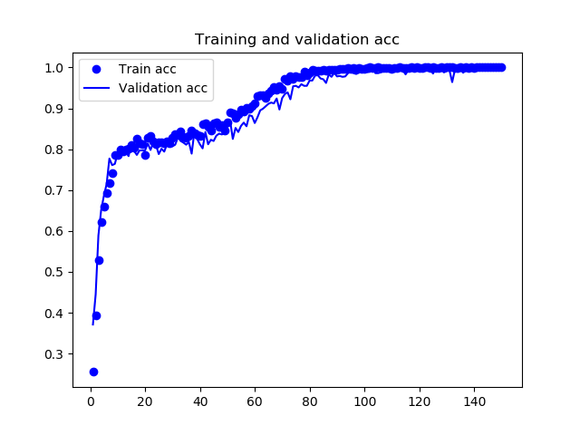
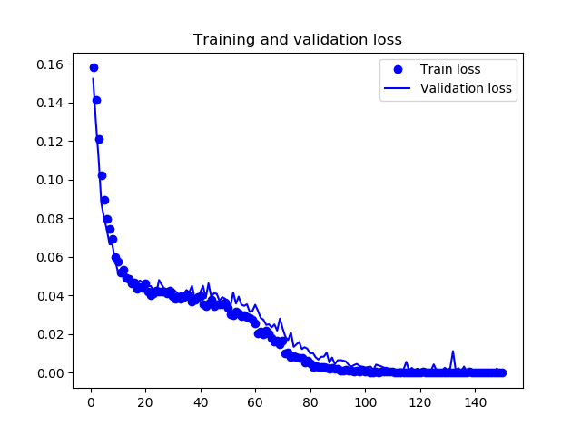
Training results
Accuracy plateaus at near 100% after 80 epochs.
Validation accuracy and loss match training values indicating that the model is not “over-fitting” the training data.

Slide 7
Testing results
Against the untouched Test set of images the model made ~ 10,000 predictions and made 28 errors.
Accuracy ~ 99.7 %
Loaded model from disk
-------------------------------
Testing Baguettes....
Test directory (c:\Github\CNNTest\GemImages\TEST\Baguette) contains 1973 files.
Predicted 1973 classes in 8.124969720840454 seconds
0 errors detected
-------------------------------
Testing Hearts....
Test directory (c:\Github\CNNTest\GemImages\TEST\Heart) contains 1985 files.
Predicted 1985 classes in 6.43539571762085 seconds
19 errors detected
-------------------------------
Testing Ovals....
Test directory (c:\Github\CNNTest\GemImages\TEST\Oval) contains 2016 files.
Predicted 2016 classes in 6.108996391296387 seconds
9 errors detected
-------------------------------
Testing Princesss....
Test directory (c:\Github\CNNTest\GemImages\TEST\Princess) contains 1976 files.
Predicted 1976 classes in 6.171136379241943 seconds
0 errors detected
-------------------------------
Testing Rounds....
Test directory (c:\Github\CNNTest\GemImages\TEST\Round) contains 2050 files.
Predicted 2050 classes in 6.35629677772522 seconds
0 errors detected

Slide 8
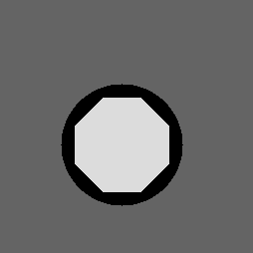
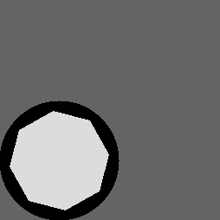
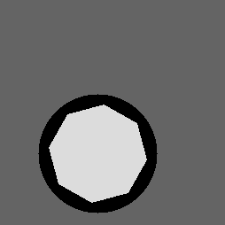
Angle estimation
In order to test the ability to train the network for rotation detection a set of images of the “Round” gem were simulated with rotations in 5º steps from 0 to 40º (octagon has a 45⁰ rotational symmetry so 0⁰ === 45⁰). 20,000 training images, 10,000 validation images and 10,000 test images were made. For the test images a random rotation in the range (-2.2 -> 2.2) was added to each image giving a near continuous range of angles for the test.
The same network structure was used as for the base classification.
0º
15º
30º

Slide 9
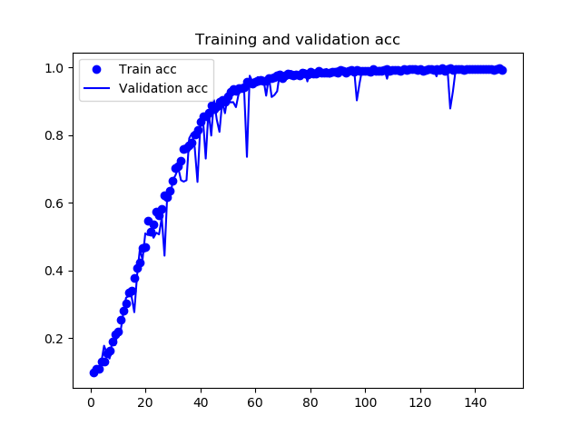
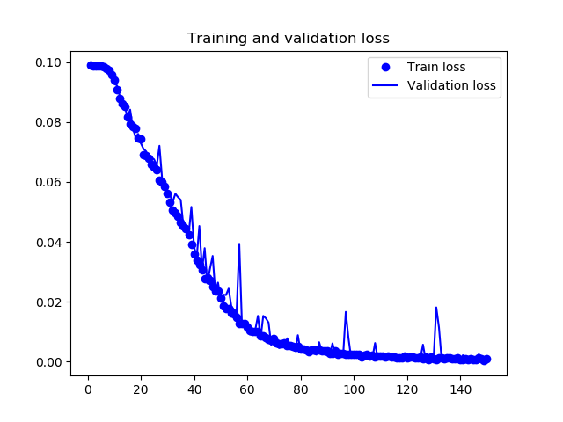
Angle test results
After training the network had a close to 100% accuracy against the validation data. Again train and validation losses were identical suggesting the model is not over-fitting.

Slide 10
Angle prediction method
The network is able to correctly classify the rotations into 5⁰ sets with near perfect accuracy, but in order to allow a finer resolution, the class weights predicted can also be used. The model predicts the probability that a image is in any of the classes. These values can be used to interpolate the real angle for the test data.
If the class is predicted as 95% chance of 5º and 5% chance of 10⁰ we could estimate the angle as 5 * 0.95 + 0.05 * 10 = 5.25º.
Using this method the network was tested against the test angle set of images which had continuous rotations. Note an error threshold of 2º was used to define an “error.”
The interpolation method requires some careful setup as the edge cases 0 and 40 degrees overlap, so combination is not trivial but doable.

Slide 11
Angle detect results
Loaded model from disk
-------------------------------
Testing angles 0 in directory c:\Github\CNNTest\GemAngle\Round\Test\0
Predicted 1126 classes in 5.211946487426758 seconds
145 errors detected with a mse of 1.6630831456567983
-------------------------------
Testing angles 10 in directory c:\Github\CNNTest\GemAngle\Round\Test\10
Predicted 1111 classes in 3.761939525604248 seconds
21 errors detected with a mse of 0.9690353296687575
-------------------------------
Testing angles 15 in directory c:\Github\CNNTest\GemAngle\Round\Test\15
Predicted 1073 classes in 3.4579520225524902 seconds
108 errors detected with a mse of 1.448823989138277
-------------------------------
Testing angles 20 in directory c:\Github\CNNTest\GemAngle\Round\Test\20
Predicted 1117 classes in 3.660788059234619 seconds
29 errors detected with a mse of 1.1231444402849495
-------------------------------
Testing angles 25 in directory c:\Github\CNNTest\GemAngle\Round\Test\25
Predicted 1141 classes in 3.824977397918701 seconds
39 errors detected with a mse of 0.8035623018642377
-------------------------------
Testing angles 30 in directory c:\Github\CNNTest\GemAngle\Round\Test\30
Predicted 1089 classes in 3.4030425548553467 seconds
23 errors detected with a mse of 0.9420277991545721
-------------------------------
Testing angles 35 in directory c:\Github\CNNTest\GemAngle\Round\Test\35
Predicted 1110 classes in 3.521953821182251 seconds
26 errors detected with a mse of 0.7172241388957005
-------------------------------
Testing angles 40 in directory c:\Github\CNNTest\GemAngle\Round\Test\40
Predicted 1113 classes in 3.6205923557281494 seconds
17 errors detected with a mse of 0.9742941024136372
-------------------------------
Testing angles 5 in directory c:\Github\CNNTest\GemAngle\Round\Test\5
Predicted 1120 classes in 3.422391414642334 seconds
73 errors detected with a mse of 1.3781812152564679
Mean square error (mse) ~ 1 degree for all sets. ~95% of data within error threshold of +/2 degrees.

Slide 12
Conclusions from tests.
Classifier is able to determine stone type from artificial images with > 99% accuracy.
Classifier + interpolation is able to detect the rotation of the stones to around +/- 1º accuracy.

Slide 13
Next steps
All training has been performed on simulated data, so the obvious next step is testing on classified real data. To do this a large set (~ 2000 images of the real stones would be required plus all the classification data. This could be augmented to around 20,000 by artificial rotation and scaling of the base images (“data augmentation”).
Edge cases (0, 5 and 40 degree rotations) were more prone to error in the angle detect. This maybe due to the model learning the rotational artefacts on the lines due to processing/simulation. This would need testing on real data where this effect would be lessened. This is a risk as the models could really just be learning the method of image simulation!
All work has been performed on a PC with a decent graphics card. Training on a CPU would take 10 – 20 x times longer (1 day per run) so purchasing a dedicated PC would be advisable.
Once real world performance is validated, feature localisation (position detection) can be investigated.

Slide 14
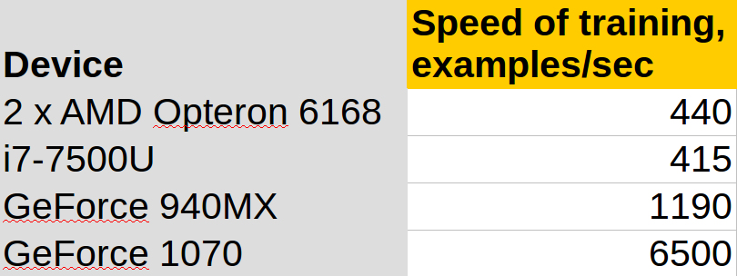
Why GPU training?

